Slide 1
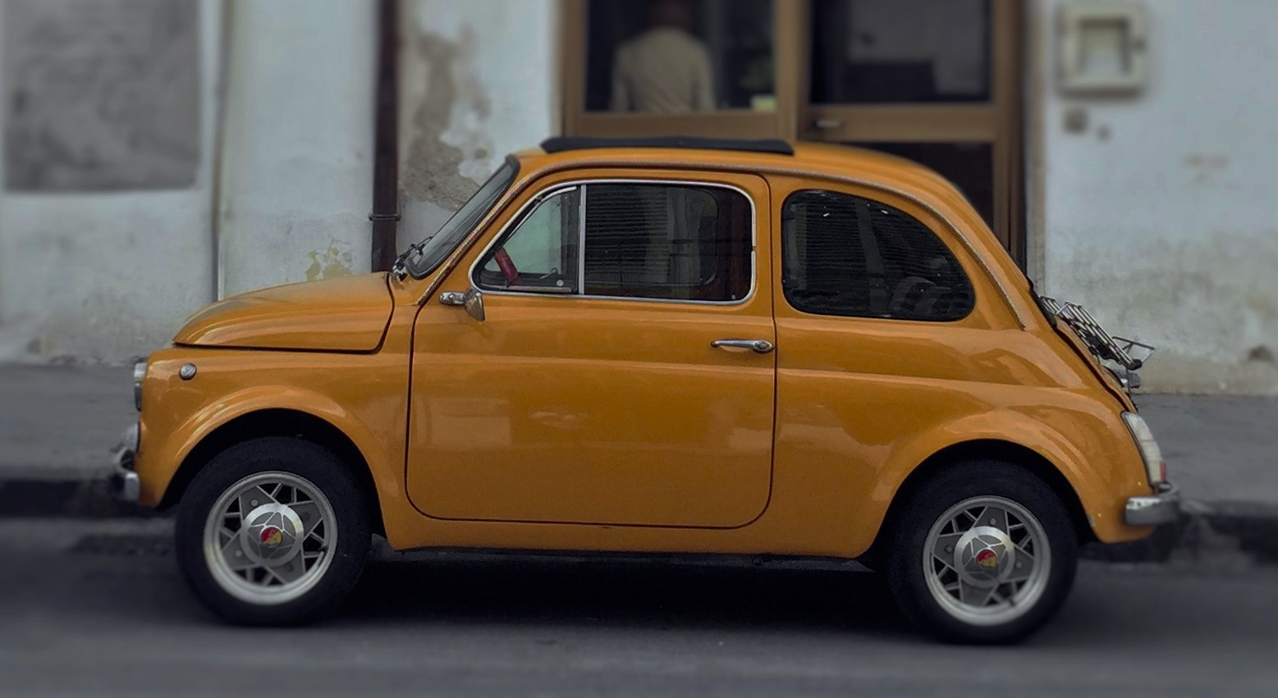

BALDASSARI
ALESSANDRO
841561
BENDIN
ALBERTO
841734
GIAROLA
FRANCESCO
840554
MY TAXI SERVICE
SOFTWARE ENGINEERING 2
A.Y. 2015/2016

Slide 2
MAIN STAKEHOLDERS & ACTORS
City Government
Taxi Company
Clients
Passenger
Taxi Driver
Administrator

Slide 3
MAIN GOALS
Web and Mobile application
Queue fair management
Ride Reservation
Multiple Notifications
Public API
Taxi Sharing

Slide 4
ASSUMPTIONS
Entitled Taxi Drivers
Predetermined City Zones
Taxi Driver manages his own availability
Ride is shared only if it is reserved
Shared rides have same pickup and destination zone
All taxis have the same capacity
Requests are turned into Rides after an appropriate time frame

Slide 5
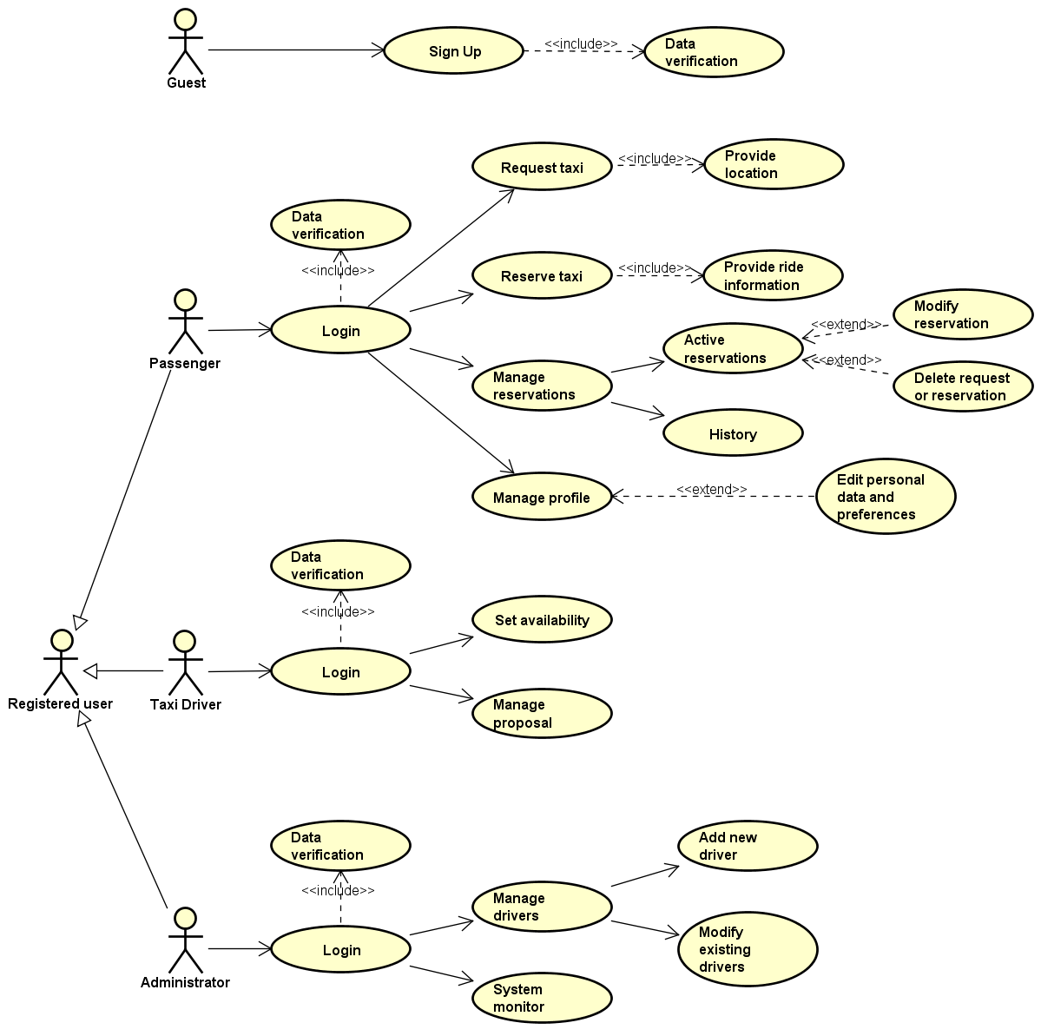
USE CASE

Slide 6
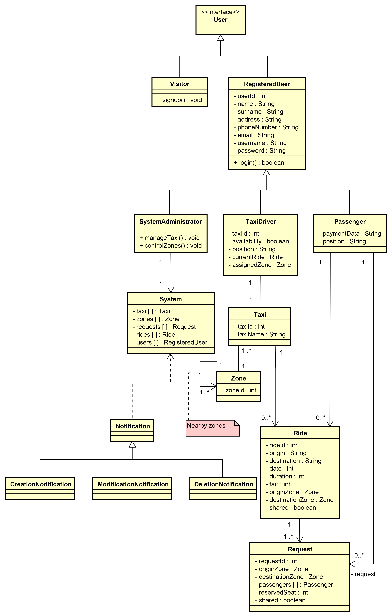
CLASS DIAGRAM

Slide 7
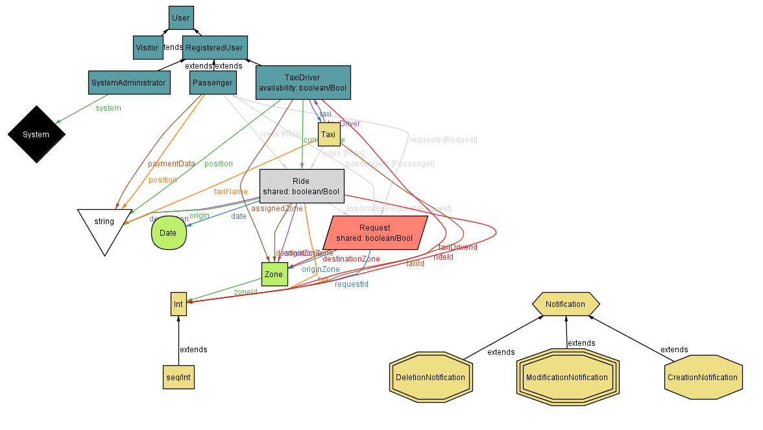
ALLOY

Slide 8
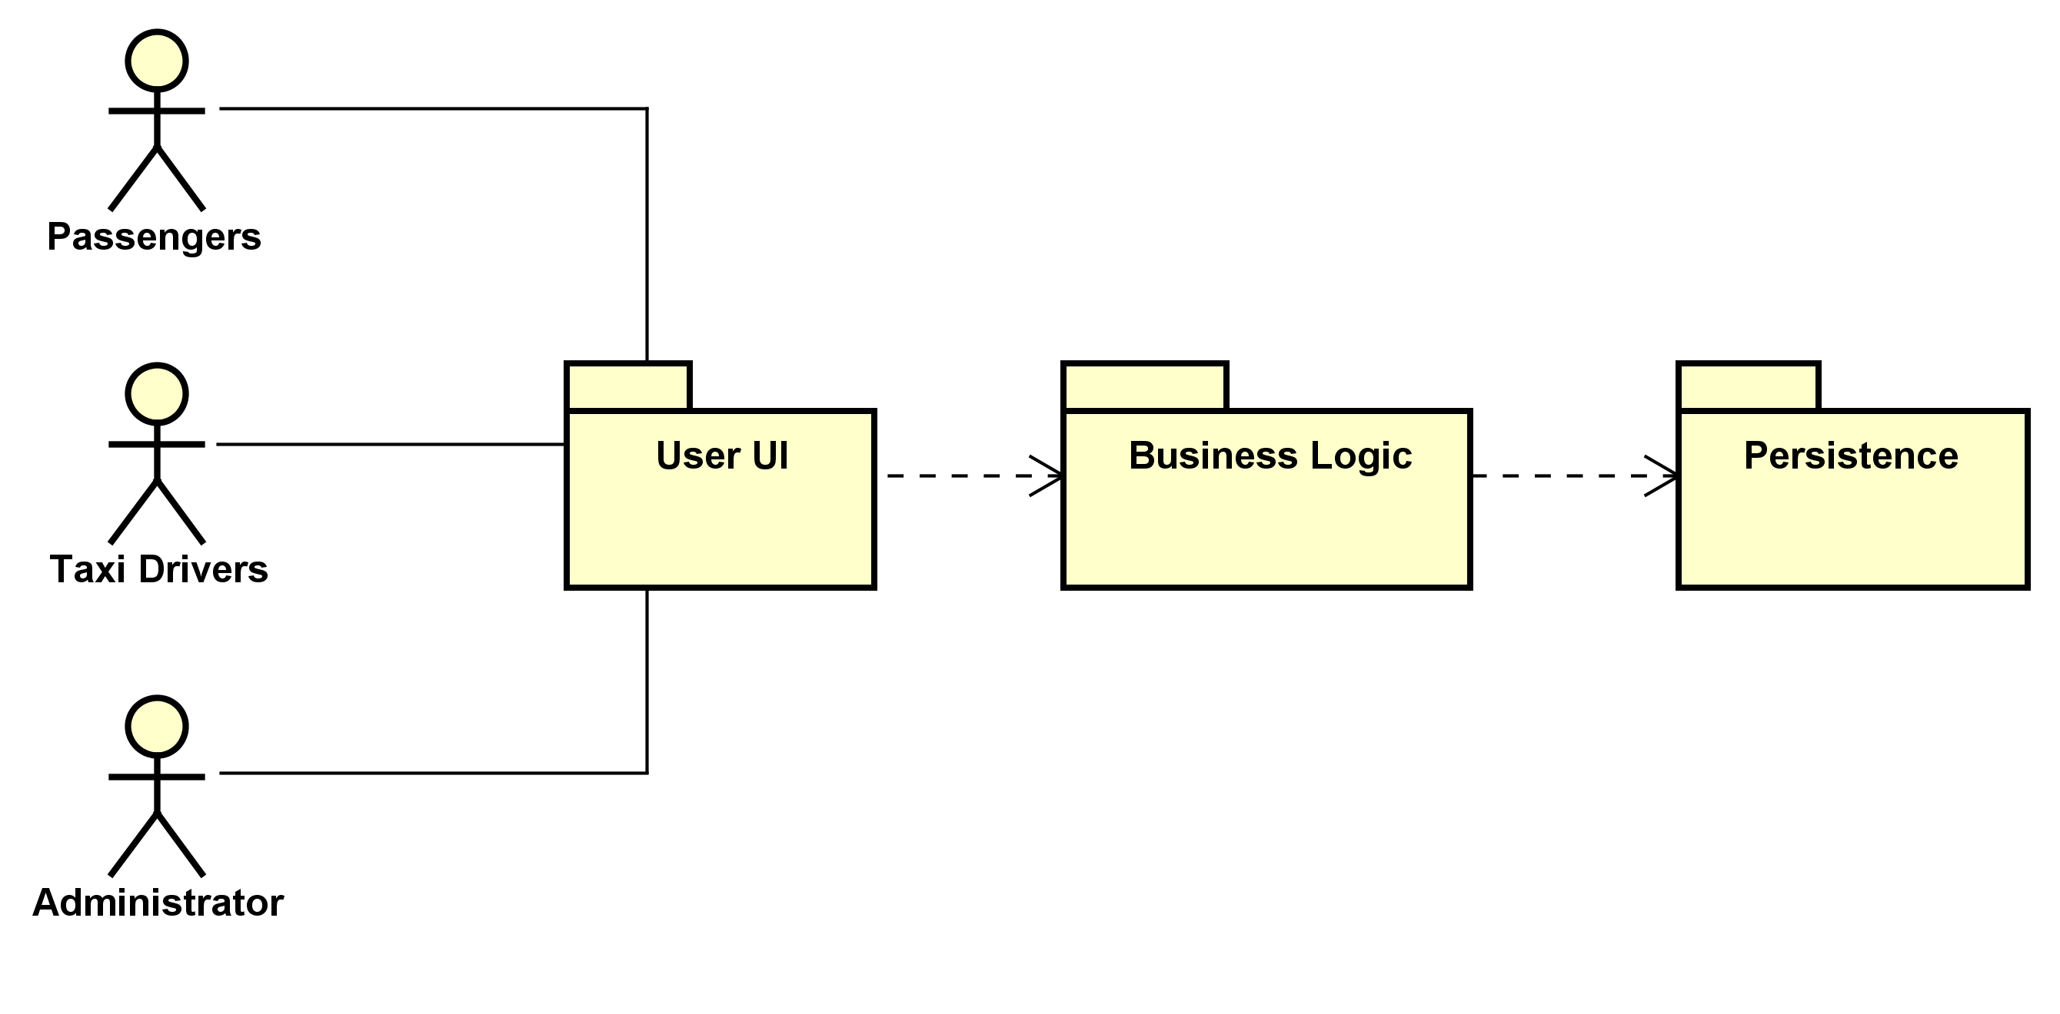
APPLICATION TIERS

Slide 9
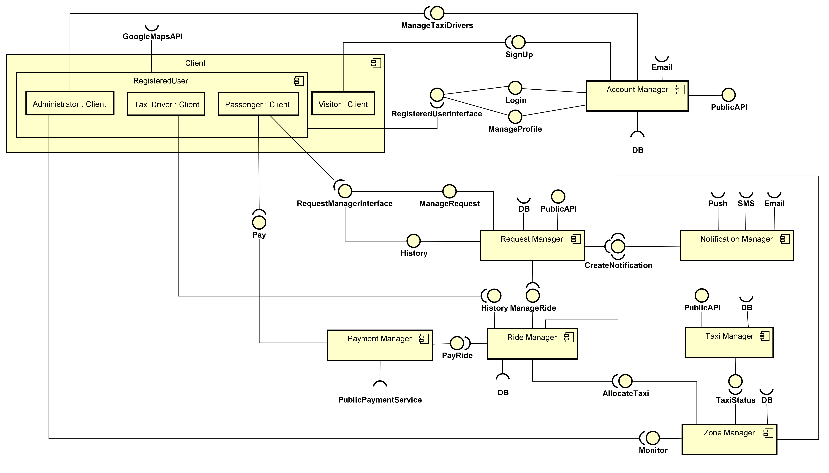
HIGH LEVEL
COMPONENT VIEW

Slide 10
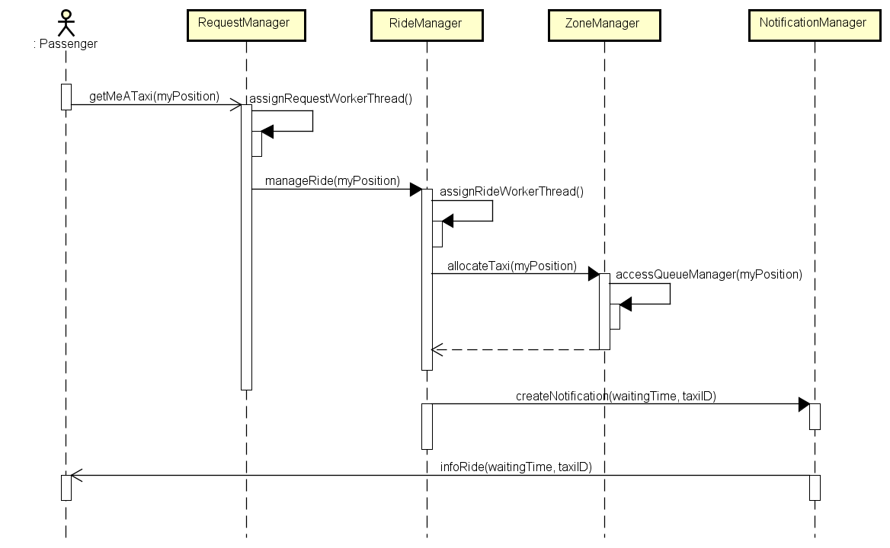
TAXI REQUEST

Slide 11
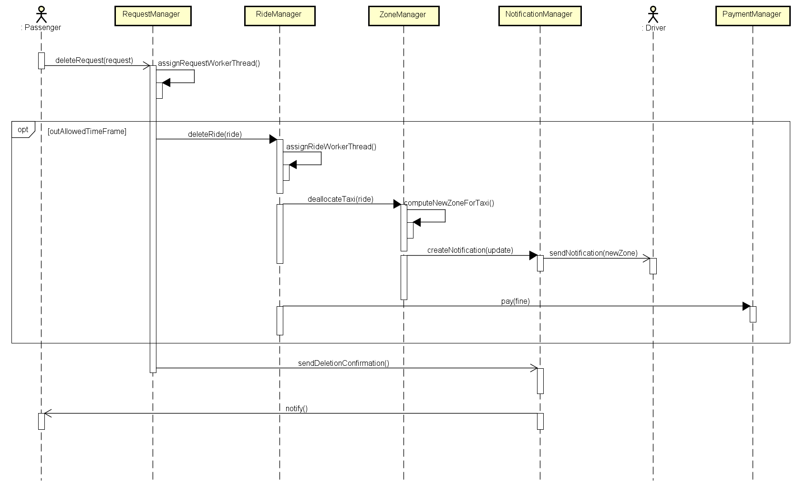
DELETE RESERVATION

Slide 12
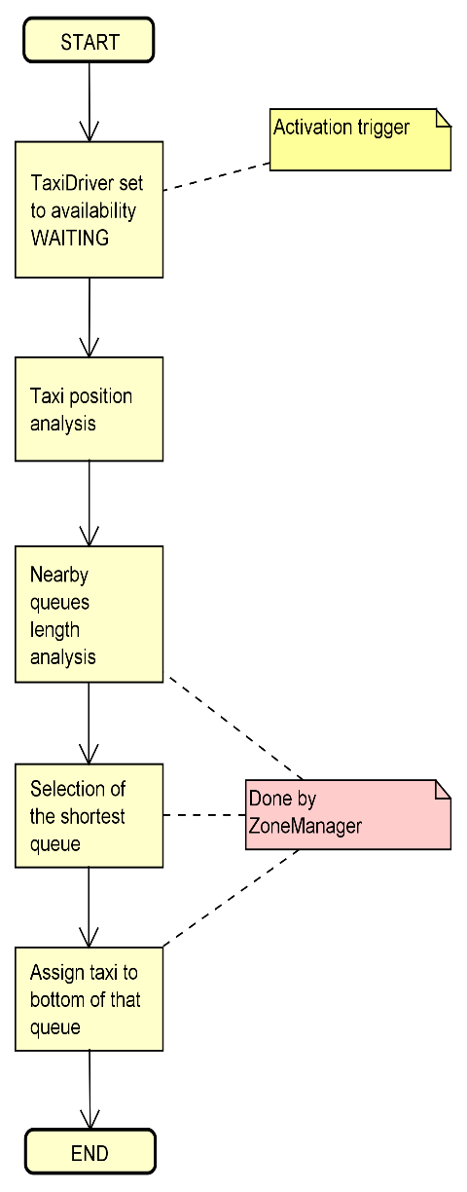
FAIR QUEUE MANAGEMENT

Slide 13
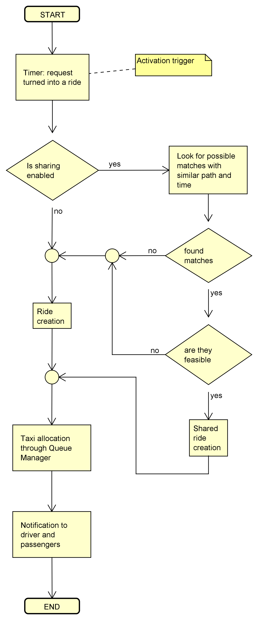
RIDE CREATION

Slide 14
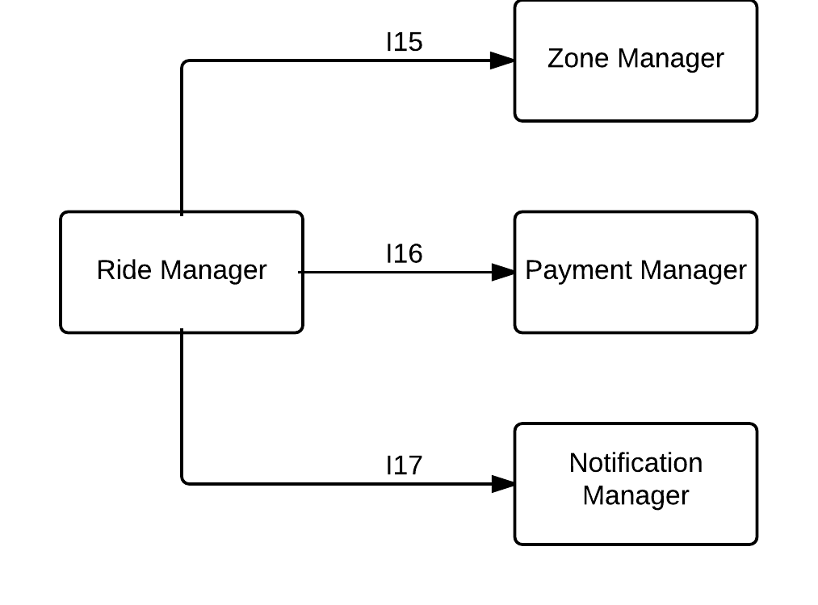
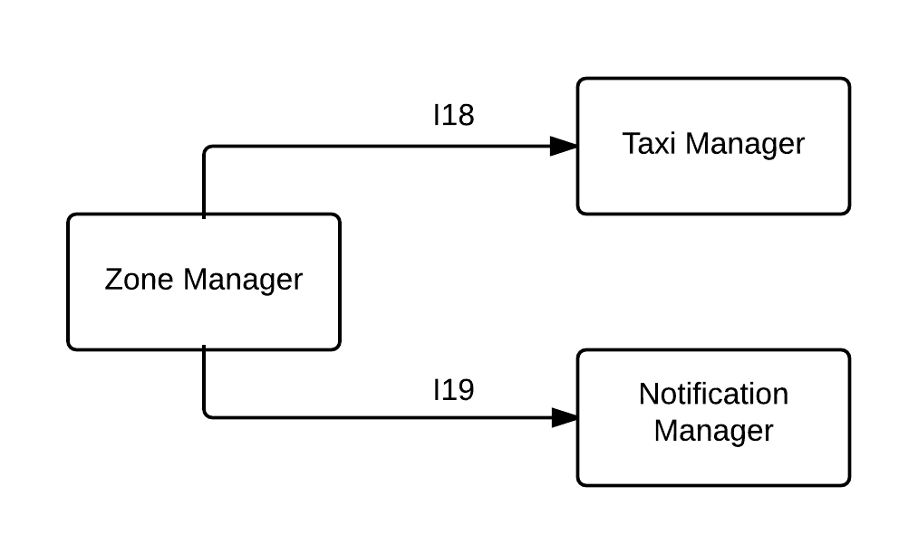
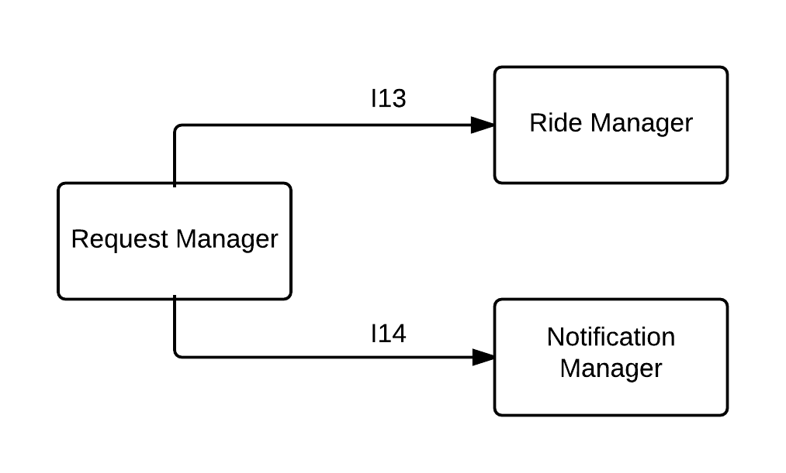
SEQUENCE OF INTEGRATION

Slide 15
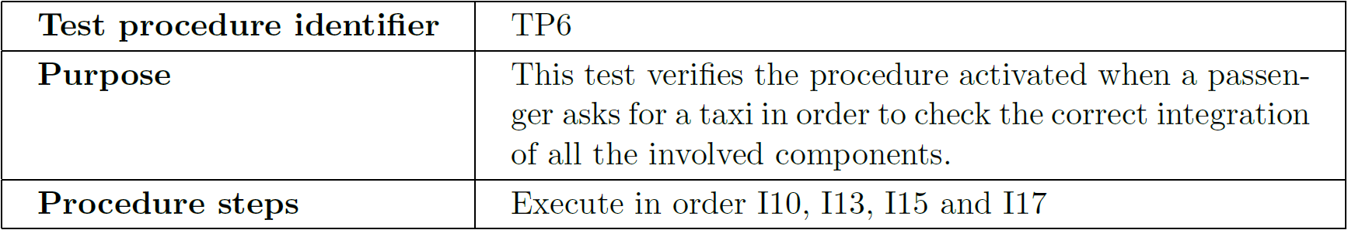
TAXI REQUEST TEST PROCEDURE

Slide 16
TESTS’ REQUIREMENTS
Program Stubs
External Notification Service
External Payment Service
Program Drivers
Test Data
Users Data
Rides
City Zones

Slide 17
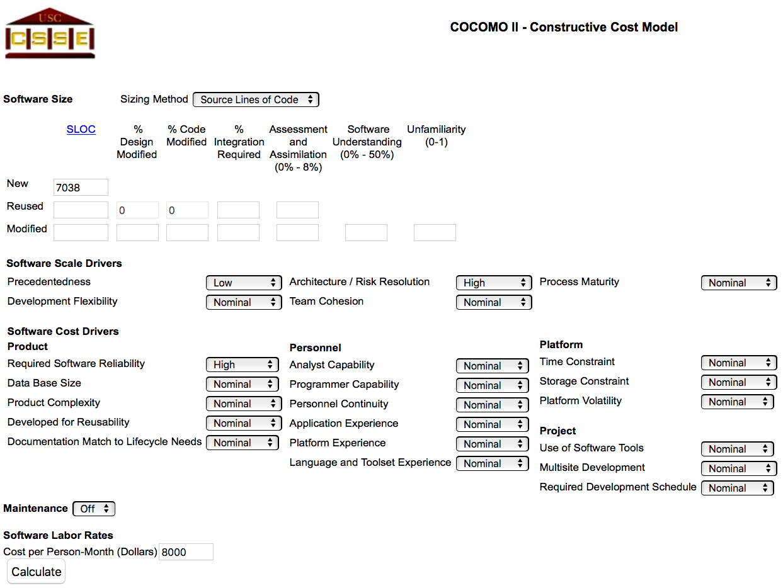
COCOMO II - SETTINGS

Slide 18
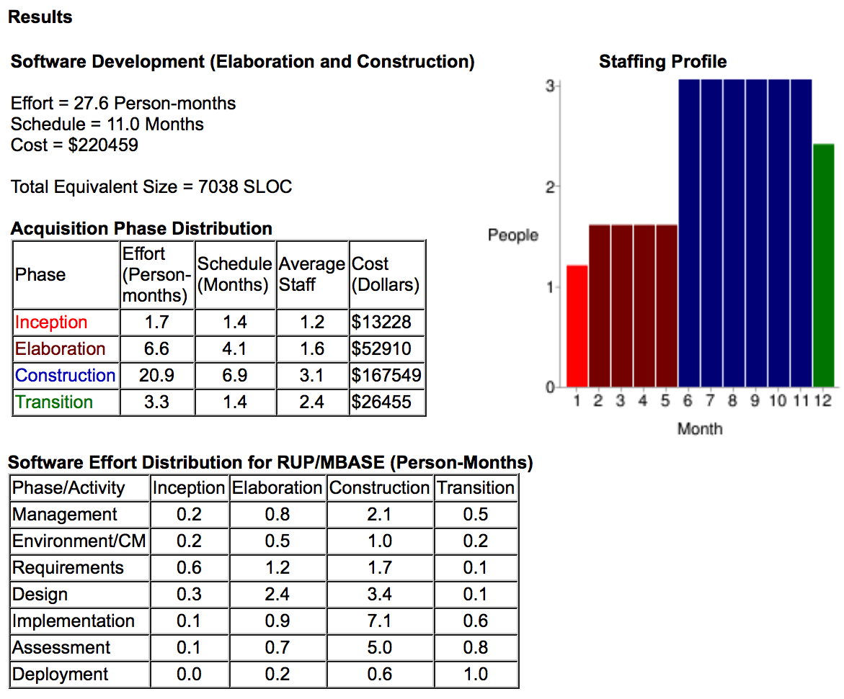
COCOMO II - RESULT

Slide 19
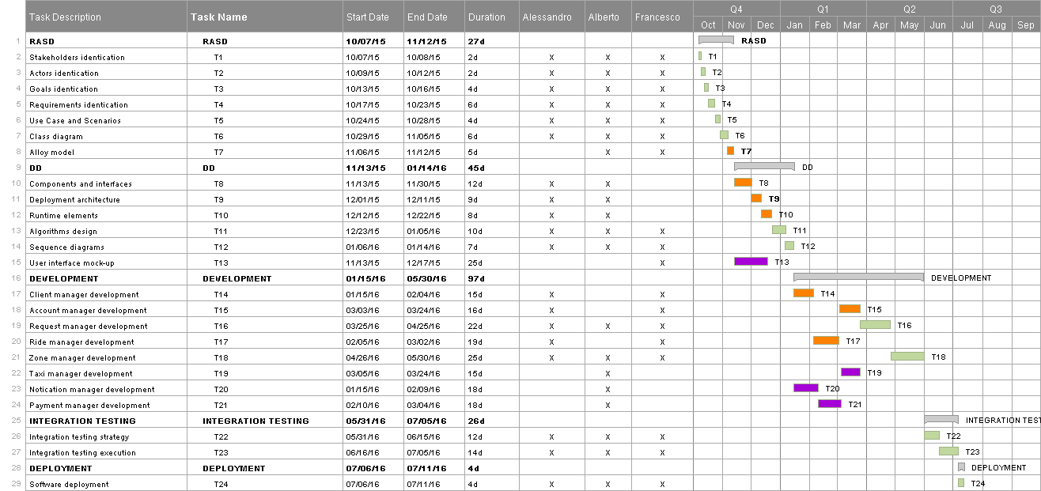
TASK SCHEDULING

Slide 20
RESOURCES ALLOCATION

Slide 21
RISK PLANNING & MANAGEMENT
Proactive strategy
Unrealistic schedule
Availability of staff
Wrong functionalities
Wrong User Interface
Bad external components
Real-time shortfalls

Slide 22

CODE INSPECTION

Slide 23


